Slide 1



Conserving evolutionary processes
Jeffrey Hanson
jeffrey.hanson@uqconnect.edu.au
jeffrey-hanson.com

Slide 2


Acknowledgements
Richard Fuller
Jonathan Rhodes
Cynthia Riginos
Hugh Possingham
Stuart Butchart
Graeme Buchanan
Carlo Rondinini
Francesco Ficetola

Slide 3
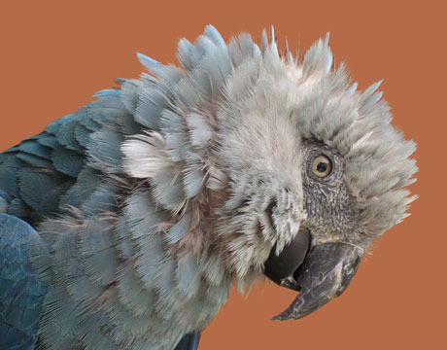
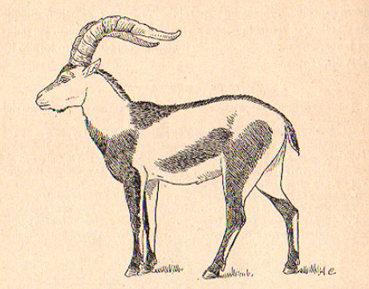
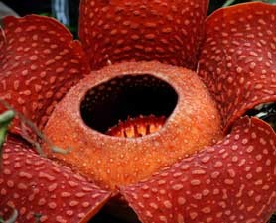
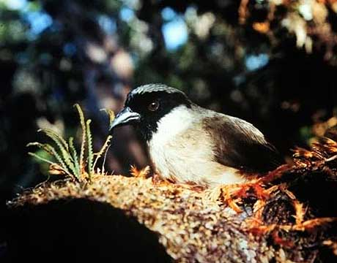
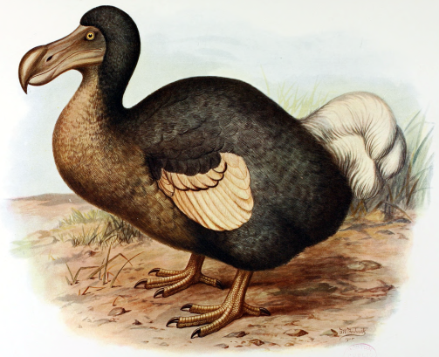
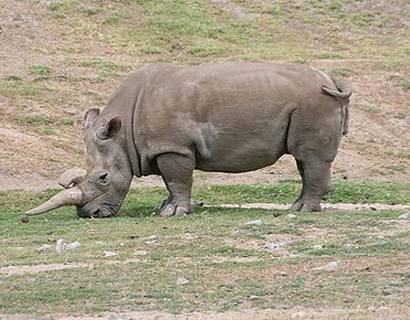
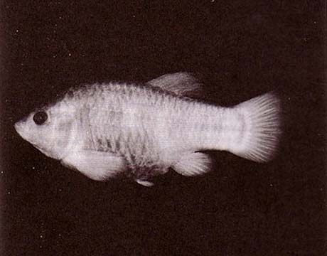
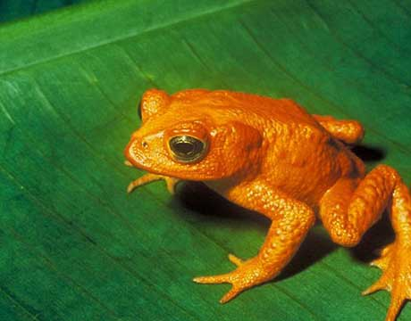
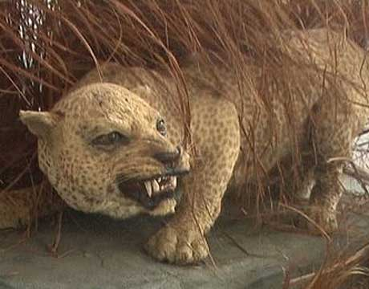
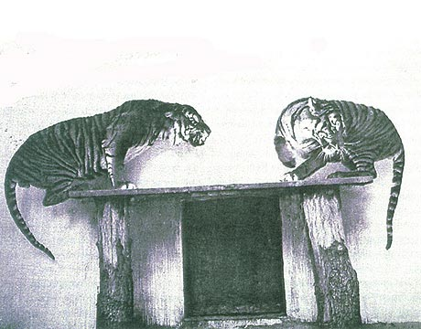
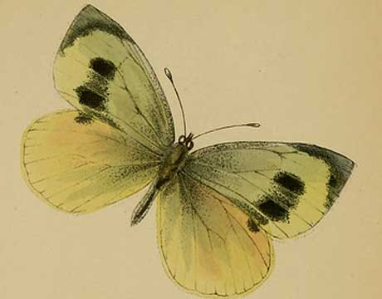
Global biodiversity crisis
Notes:
- high extinction rate
- conservation aims to maintain existing patterns of biodiversity and the processes that sustain them
- areas set aside to preserve biodiversity, and spearhead direct management actions

Slide 4
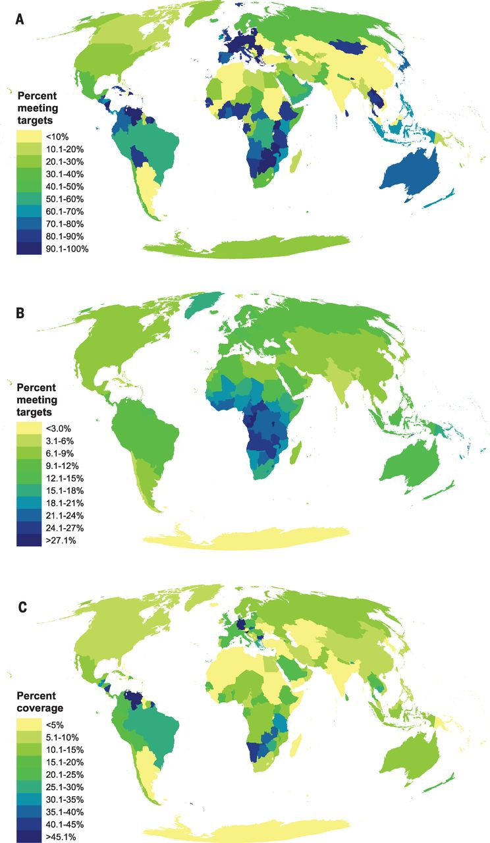
Protected areas
Runge et al. (2015) Science, 350: 1255-1258.

Slide 5
Reserve Selection
Notes:
- not all remaining habitat can be preserved
- achieve conservation objectives for minimal cost
- modern systematic conservation planning primarily focusses on representing species
- however, this ignores intra-specific biodiversity

Slide 6
Reserve Selection

Slide 7
Reserve Selection

Slide 8
Evolutionary processes
Species range
Population

Slide 9
Evolutionary processes
Species range
Population

Slide 10
Evolutionary processes
Species range
Population

Slide 11
Evolutionary processes
Species range
Population

Slide 12
Environmental and geographic variables are effective surrogates for conservation planning
Hanson et al. (2017) Under review.

Slide 13
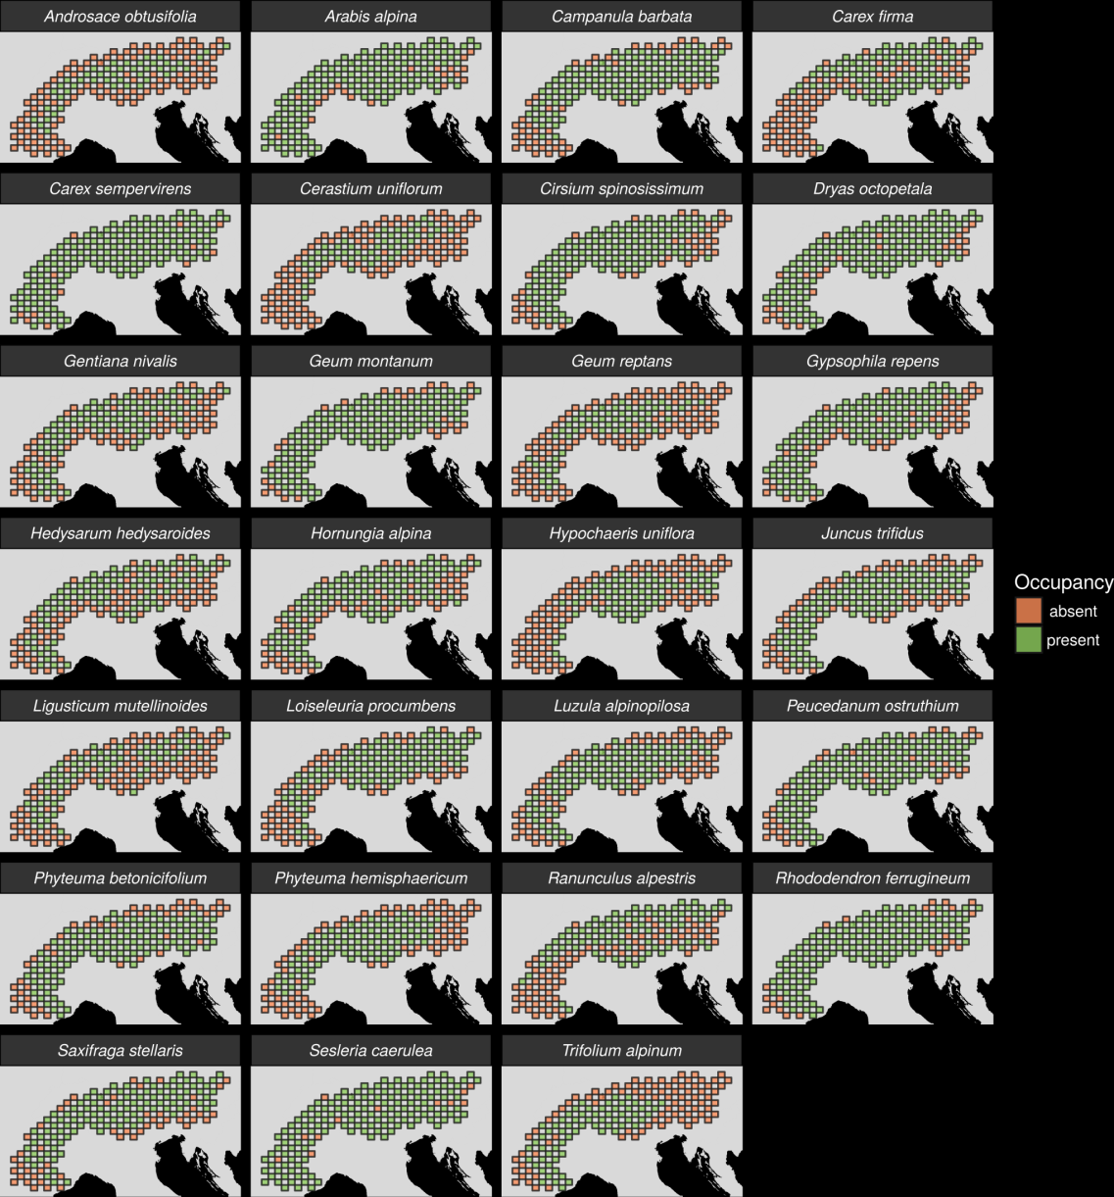
27 plant species
Different dispersal modes
Different life-histories
Different niches

Slide 14
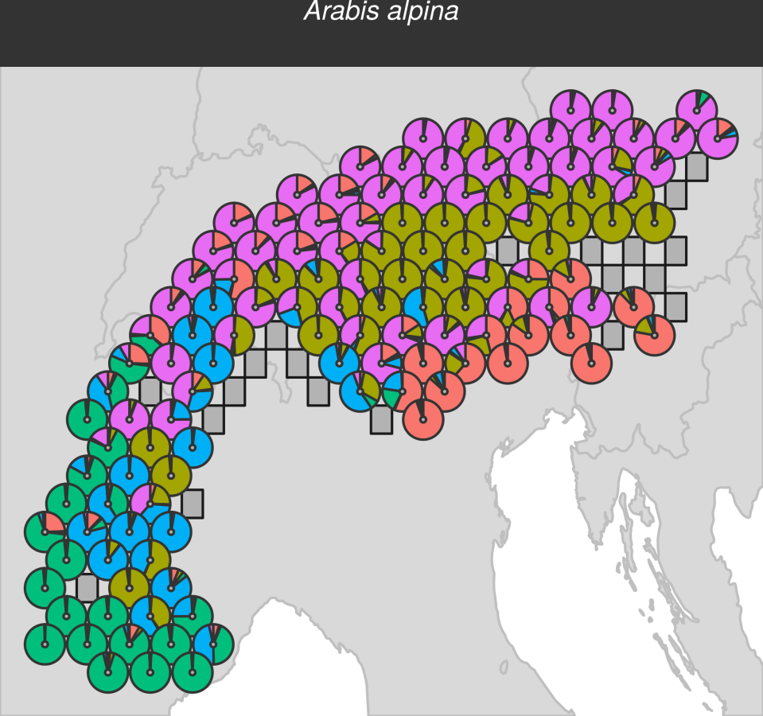
Identifying loci under selection
Structure + ClumPP analysis
Remove uncertain individuals
Remove rare alleles
Run BayeScan
Run PCAdapt
Merge results
Run NMDS on adaptive loci
Run NMDS on neutral loci

Slide 15
Identifying loci under selection
Structure + ClumPP analysis
Remove uncertain individuals
Remove rare alleles
Run BayeScan
Run PCAdapt
Merge results
Run NMDS on adaptive loci
Run NMDS on neutral loci

Slide 16
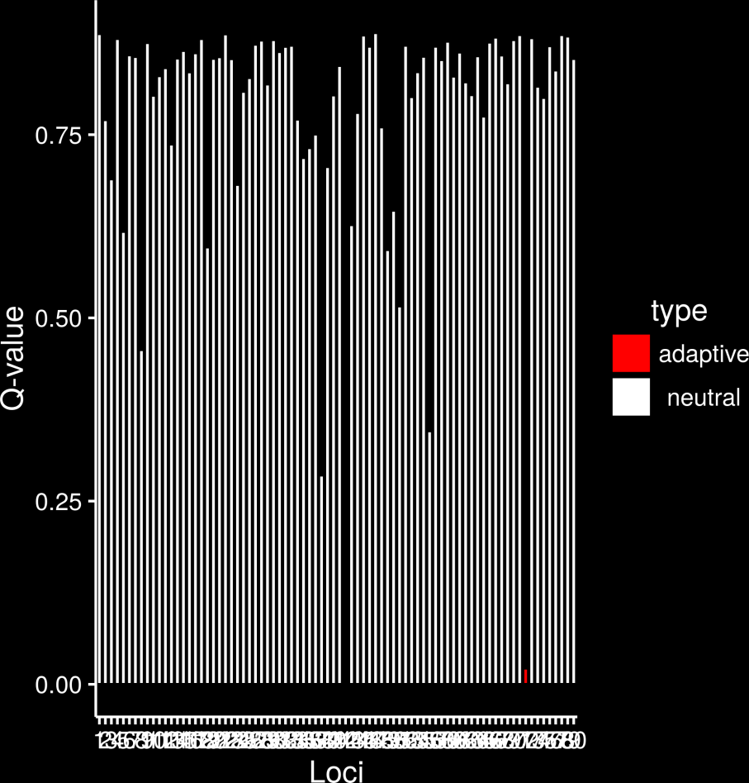
Identifying loci under selection
Structure + ClumPP analysis
Remove uncertain individuals
Remove rare alleles
Run BayeScan
Run PCAdapt
Merge results
Run NMDS on adaptive loci
Run NMDS on neutral loci

Slide 17
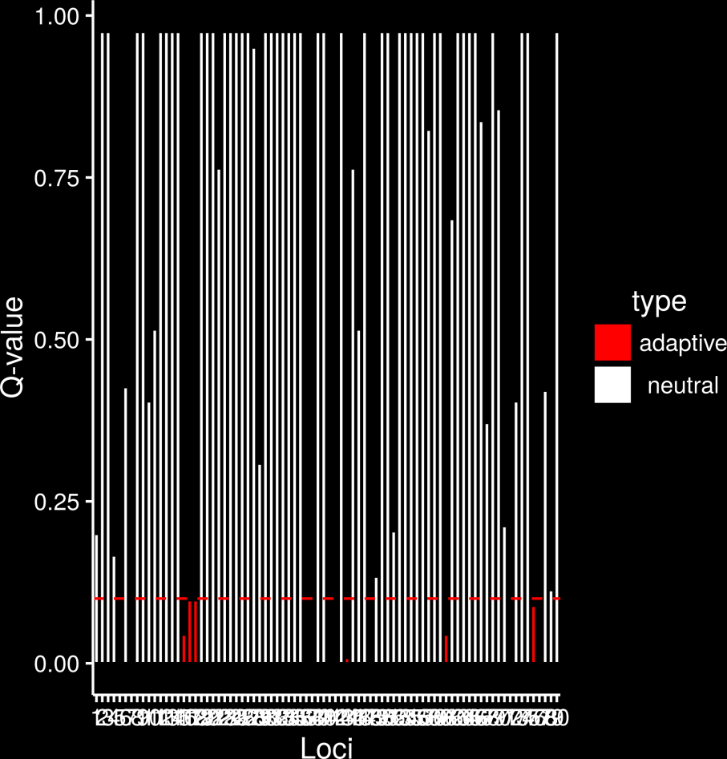
Identifying loci under selection
Structure + ClumPP analysis
Remove uncertain individuals
Remove rare alleles
Run BayeScan
Run PCAdapt
Merge results
Run NMDS on adaptive loci
Run NMDS on neutral loci

Slide 18
Identifying loci under selection
Structure + ClumPP analysis
Remove uncertain individuals
Remove rare alleles
Run BayeScan
Run PCAdapt
Merge results
Run NMDS on adaptive loci
Run NMDS on neutral loci

Slide 19
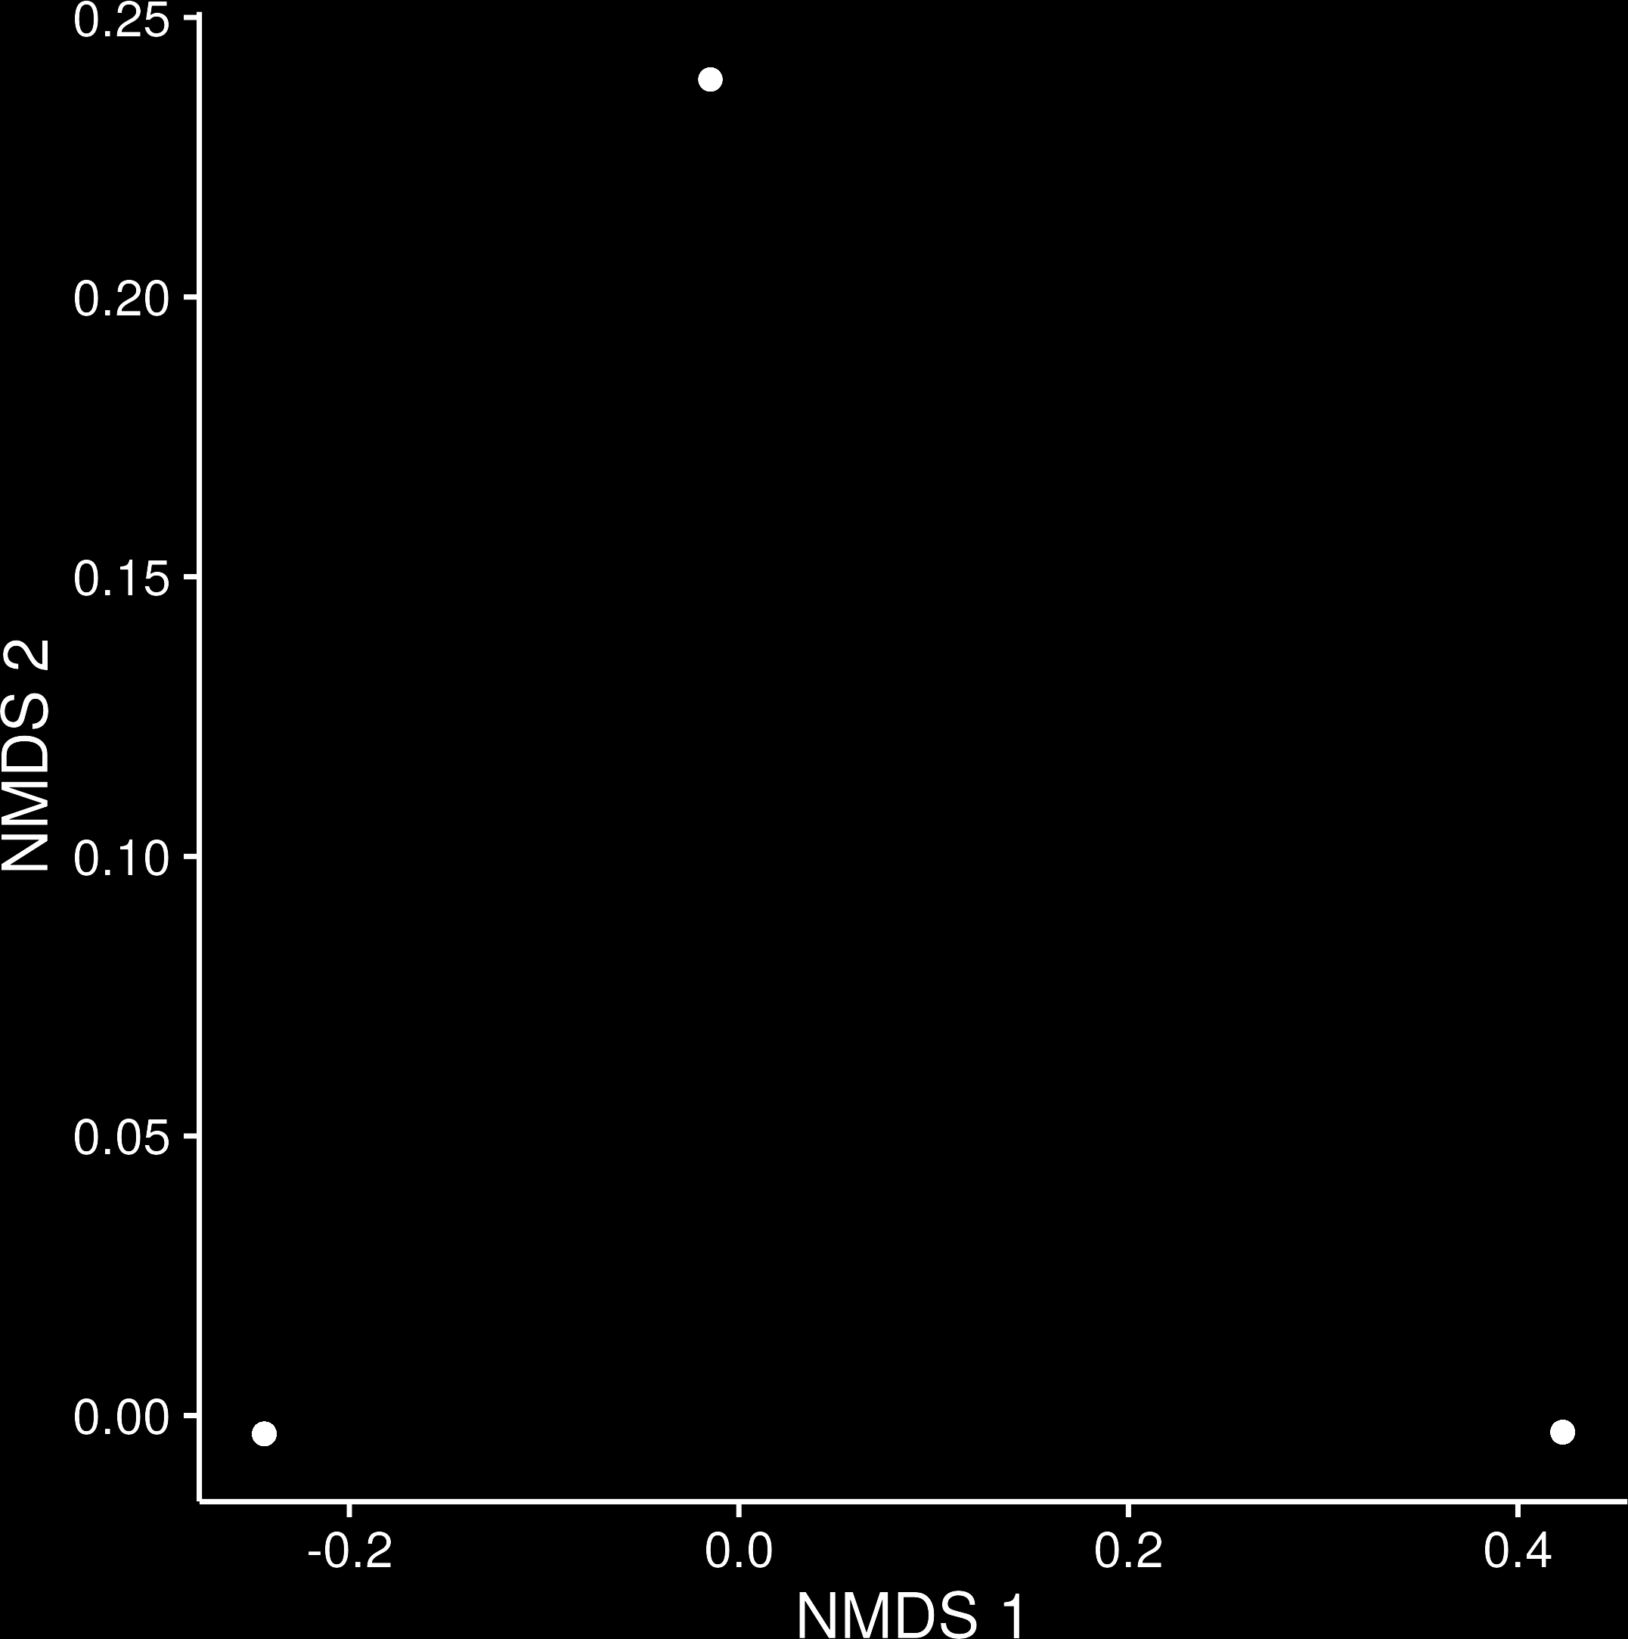
Identifying loci under selection
Structure + ClumPP analysis
Remove uncertain individuals
Remove rare alleles
Run BayeScan
Run PCAdapt
Merge results
Run NMDS on adaptive loci
Run NMDS on neutral loci

Slide 20
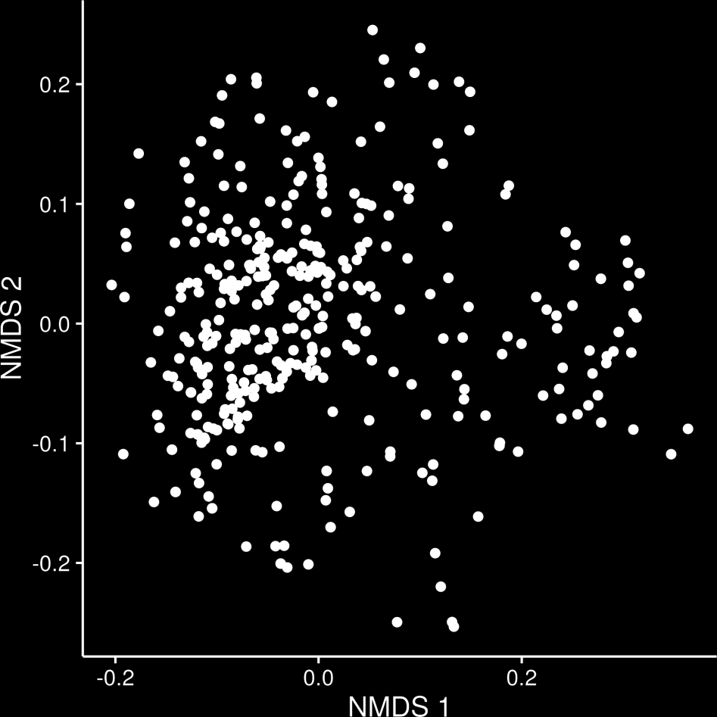
Identifying loci under selection
Structure + ClumPP analysis
Remove uncertain individuals
Remove rare alleles
Run BayeScan
Run PCAdapt
Merge results
Run NMDS on adaptive loci
Run NMDS on neutral loci

Slide 21
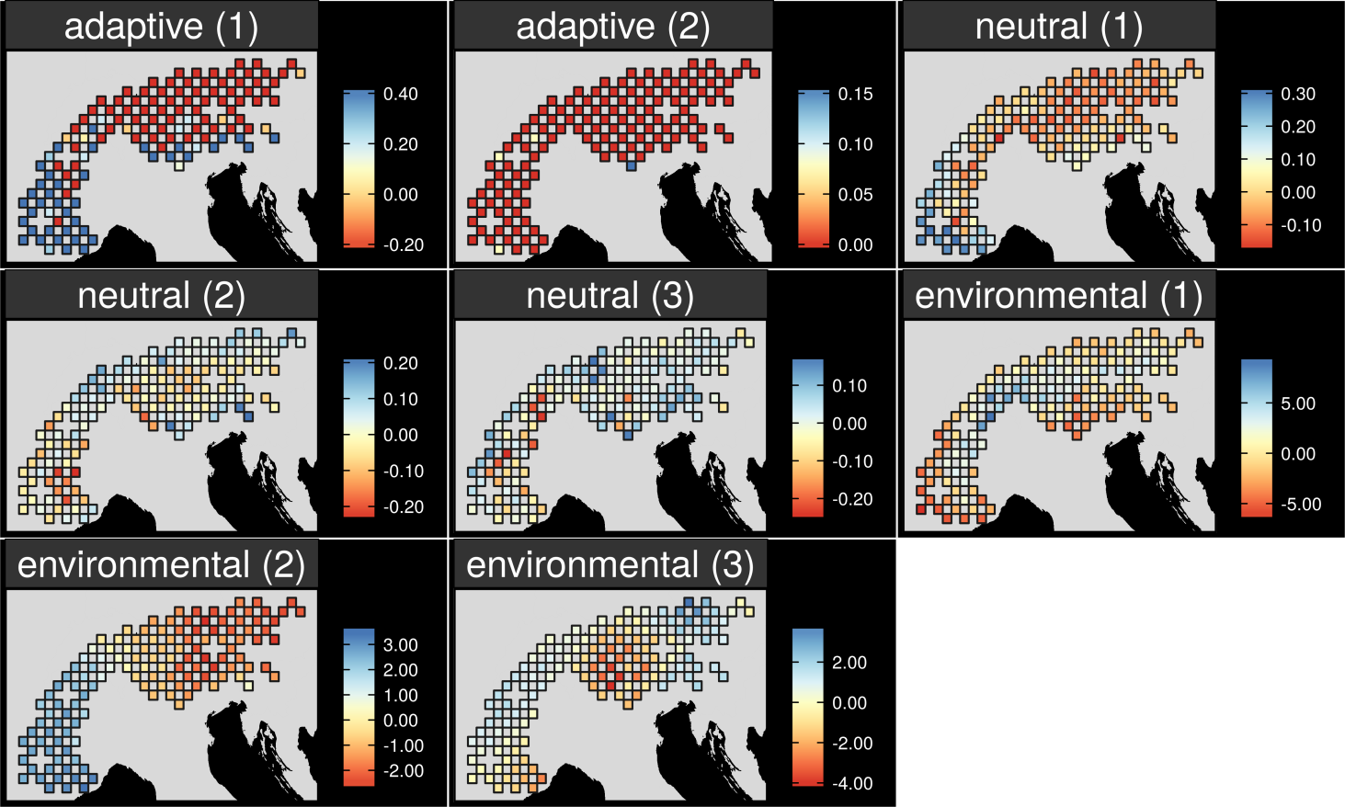
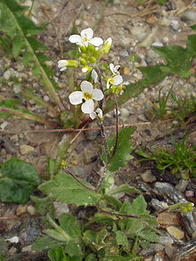
Map intra-specific genetic variation
Arabis alpina

Slide 22
Map intra-specific genetic variation
Arabis alpina

Slide 23
Map intra-specific genetic variation
Arabis alpina

Slide 24
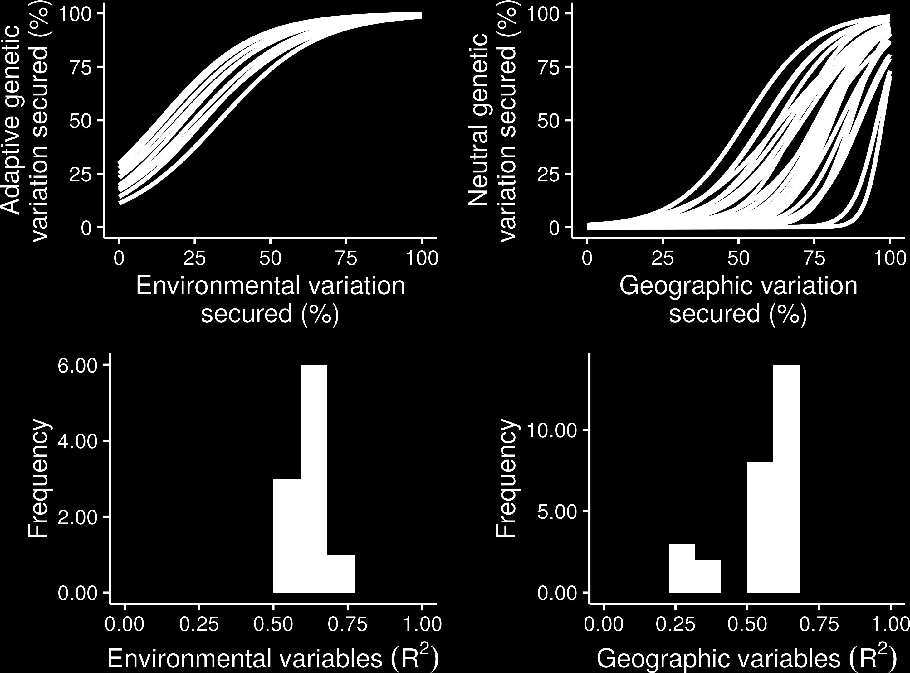
What is the relationship?

Slide 25
What is the relationship?

Slide 26
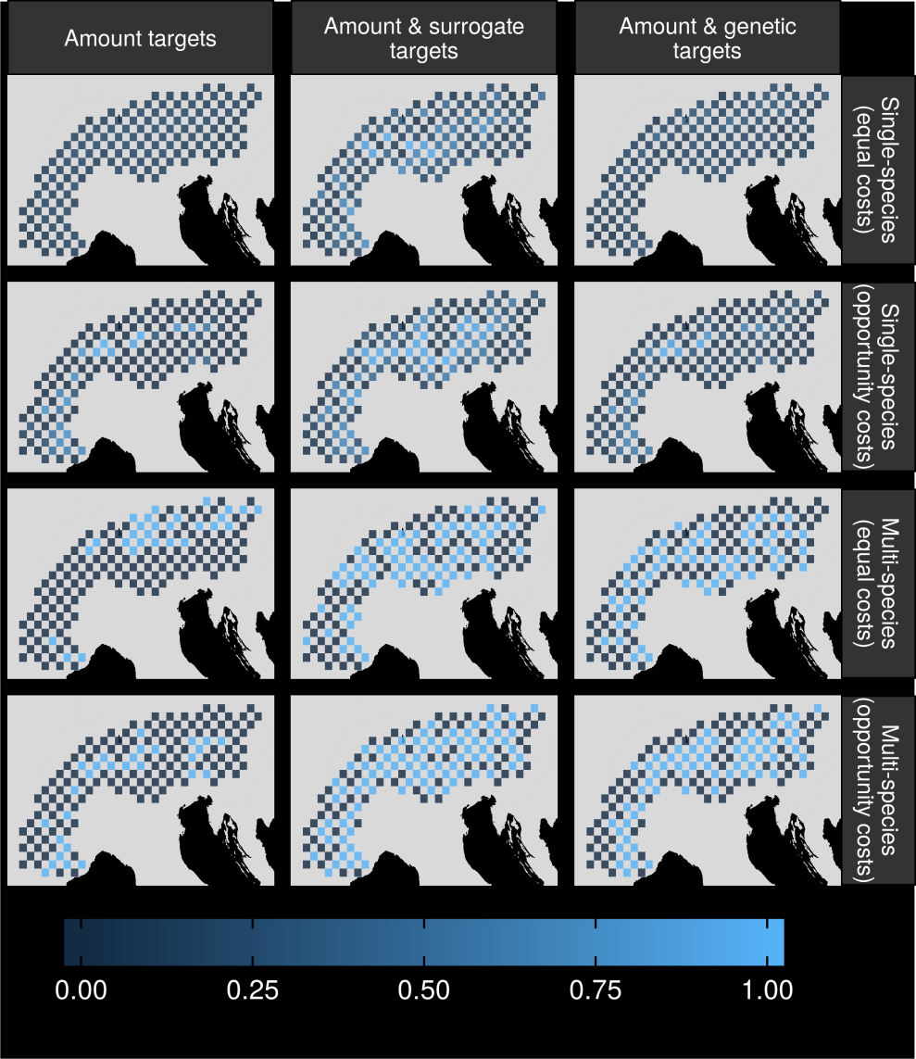
Can we make better decisions using surrogates?

Slide 27
Can we make better decisions using surrogates?

Slide 28
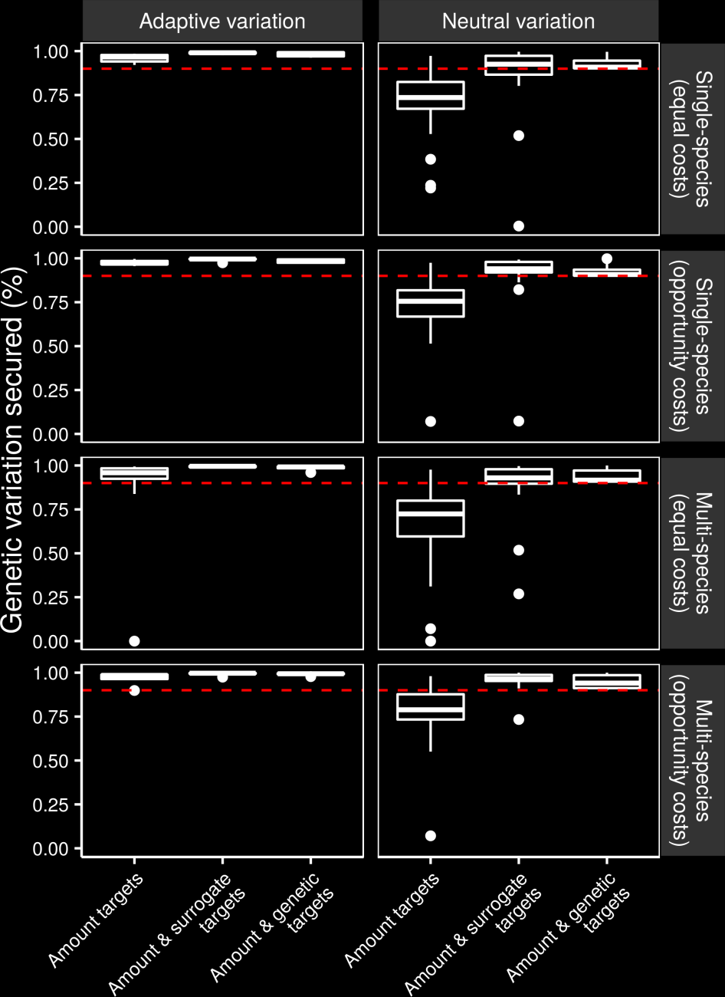
Can we make better decisions using surrogates?

Slide 29
Can we make better decisions using surrogates?

Slide 30
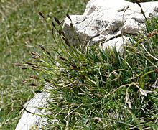
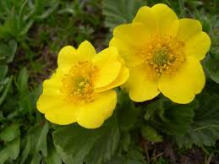
Surrogate performance
Effective for most species
Conventional methods may capture adaptive variation
Performance of geographic distances may depend on dispersal mechanisms

Slide 31


Is habitat suitability an effective surrogate for gene flow in conservation planning?
Preliminary results
Hanson et al. (2017) In prep.

Slide 32
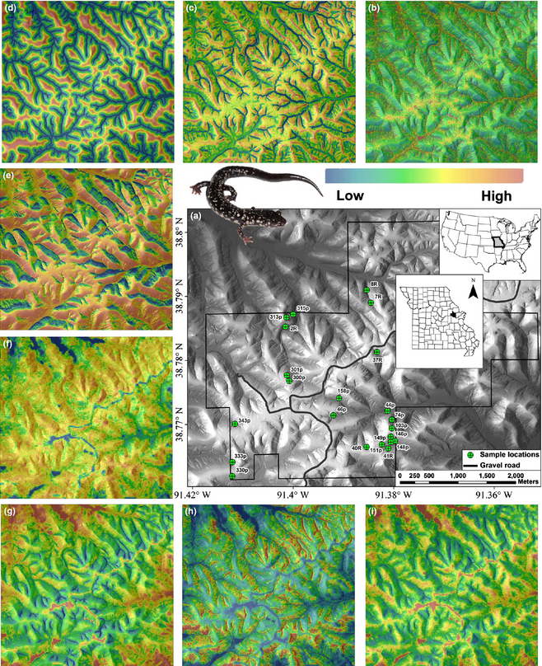
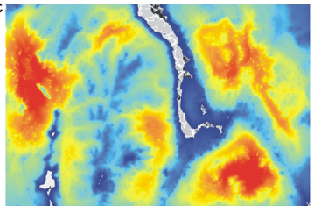
Landscape resistance
Peterman et al. (2014) Molecular Ecology. 23: 2402-2413

Slide 33
Reserve selection
Habitat suitability
Dispersible habitat
Solution

Slide 34
Reserve selection
Habitat suitability
Surrogate
Solution

Slide 35
Solution performance
Genetic-based solution
Surrogate-based solution

Slide 36
Solution performance
Genetic-based solution
Dispersible habitat
Surrogate-based solution
Maximum 8 units of
connected habitat
Maximum 5 units of
connected habitat

Slide 37
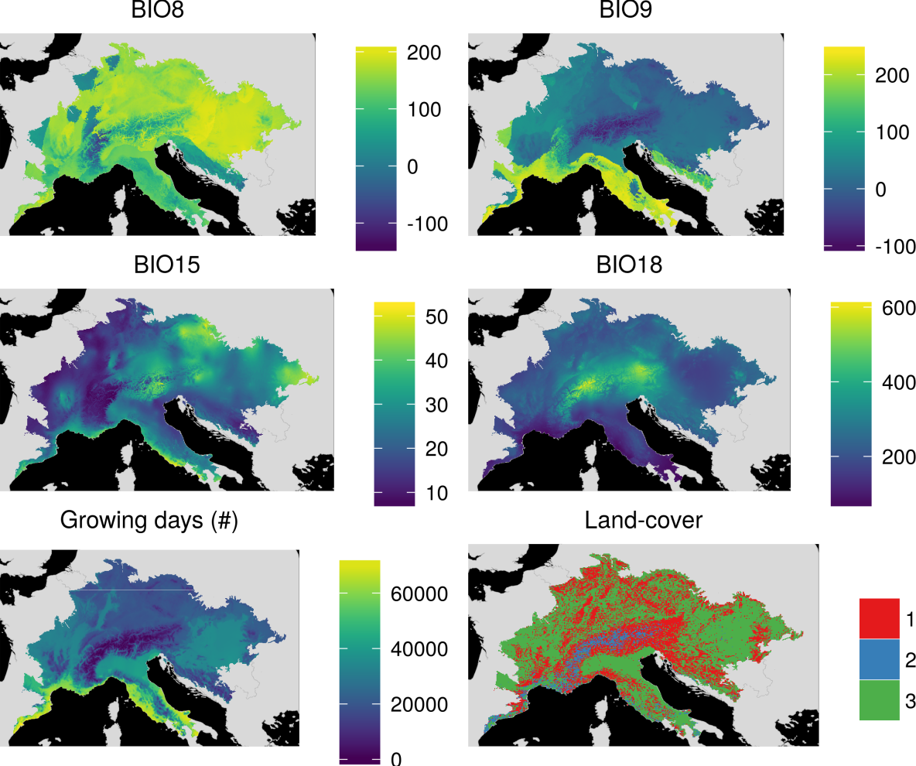
Data

Slide 38
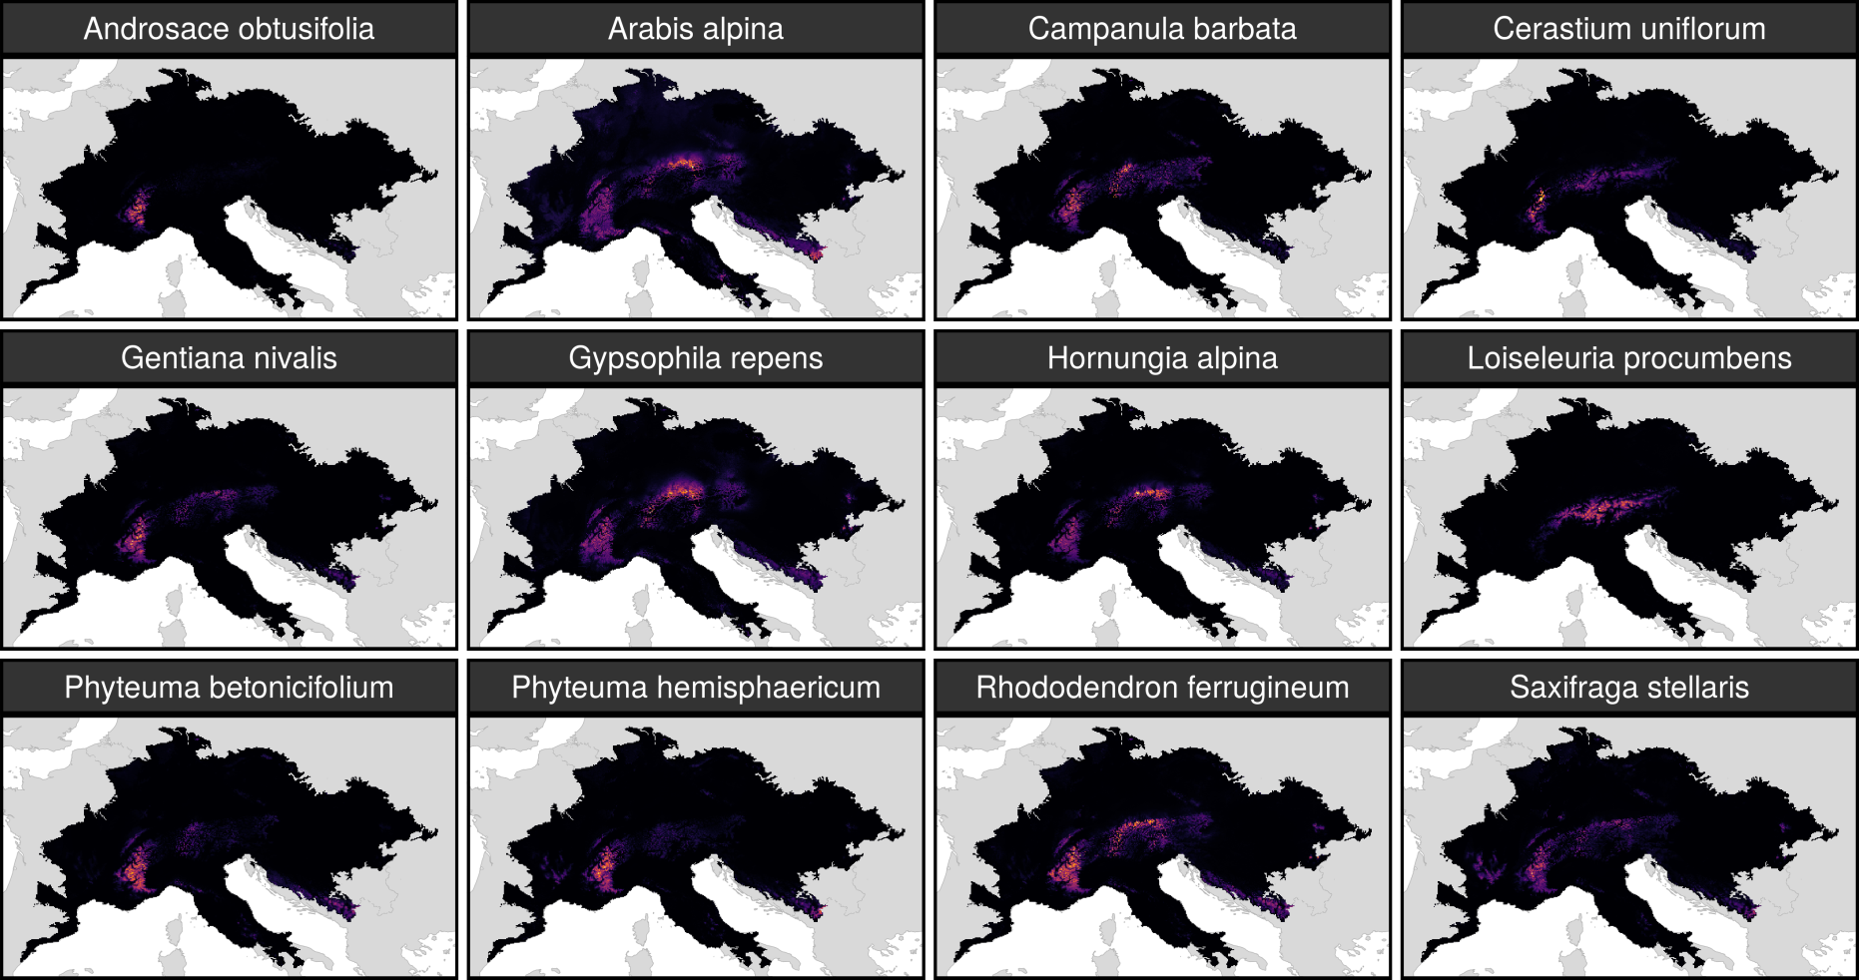
Habitat suitability models

Slide 39
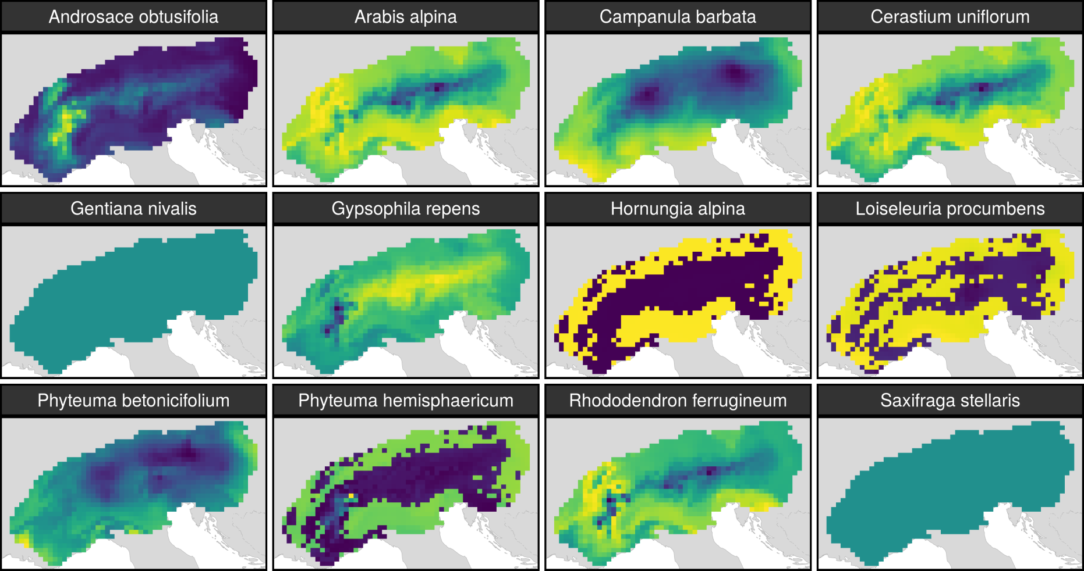
Landscape resistance

Slide 40
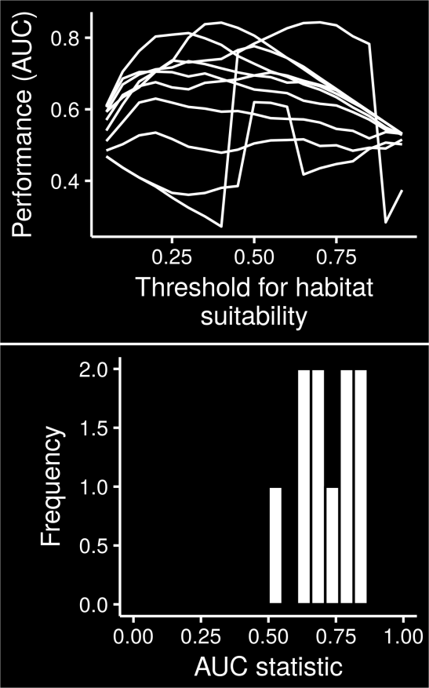
Calibration

Slide 41
Calibration

Slide 42
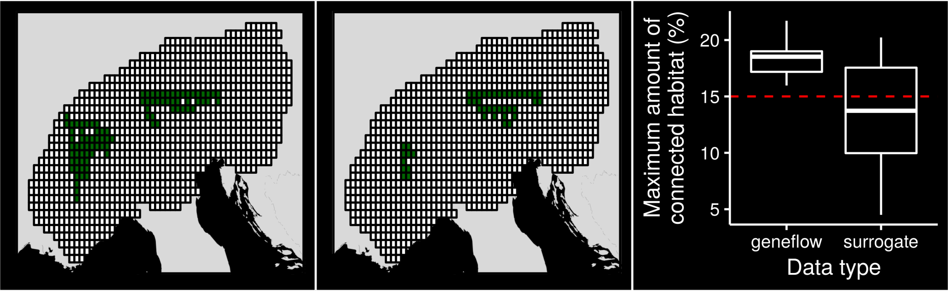
Effective for some species?

Slide 43
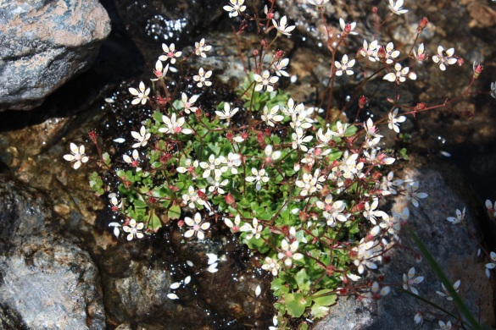
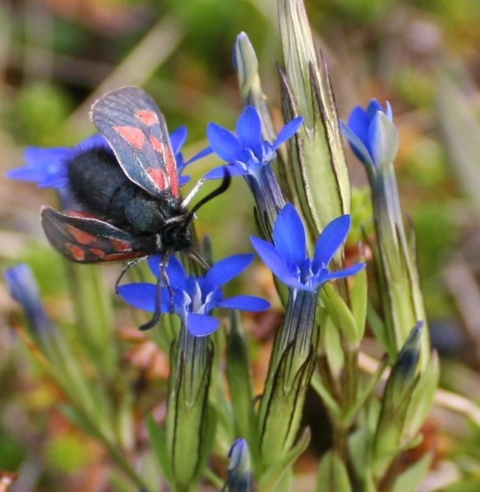
Habitat as a surrogate for gene flow
Might work for some species
Complicated by dispersal mechanisms
Incorporate species-specific connectivity into prioritizations

Slide 44
Global conservation of realized niches
How well are species’ realized niches conserved in protected areas?
Which places offer the greatest conservation benefit?
Hanson et al. (2017) In prep.

Slide 45
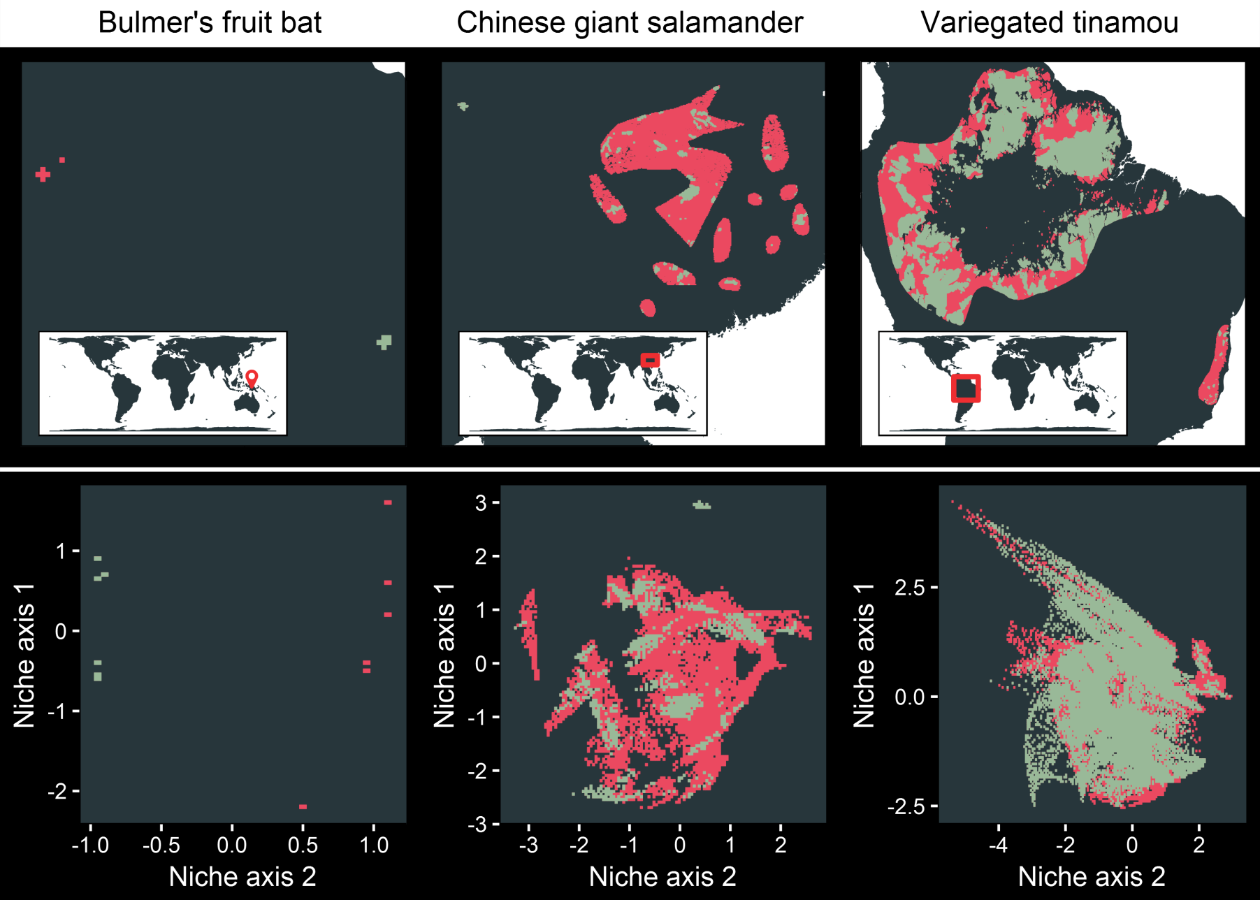
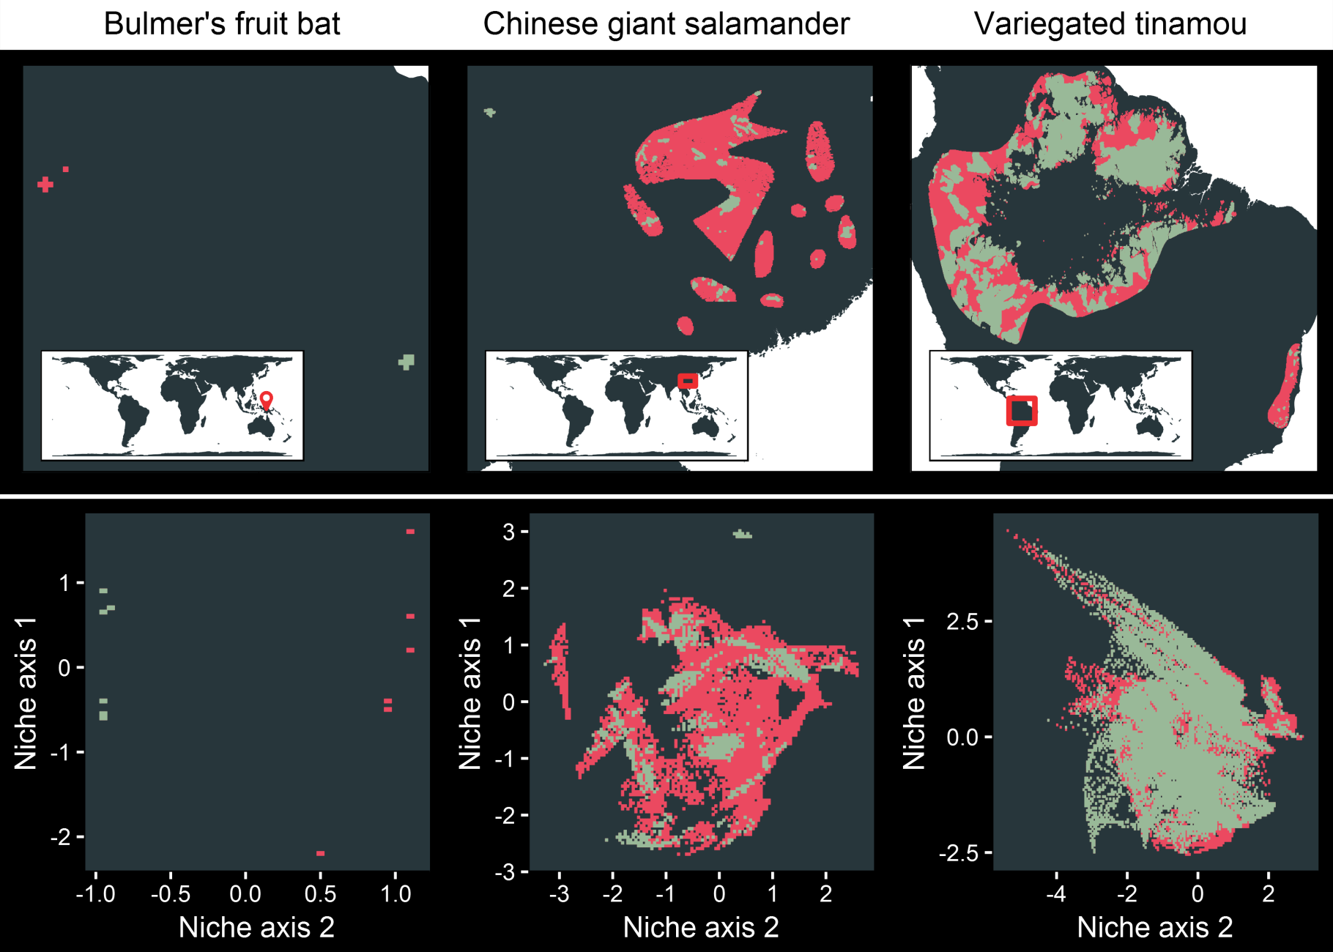
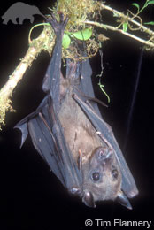
Niche representation metrics
Bulmer’s fruit bat
Geographic space
Niche space
Niche variation
sampled = 0.01 %
Niche volume
protected = 53 %

Slide 46
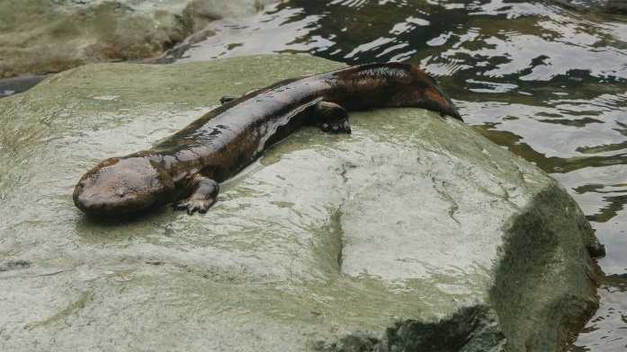
Niche representation metrics
Chinese giant salamander
Geographic space
Niche space
Niche variation
sampled = 98.22 %
Niche volume
protected = 14.01 %

Slide 47
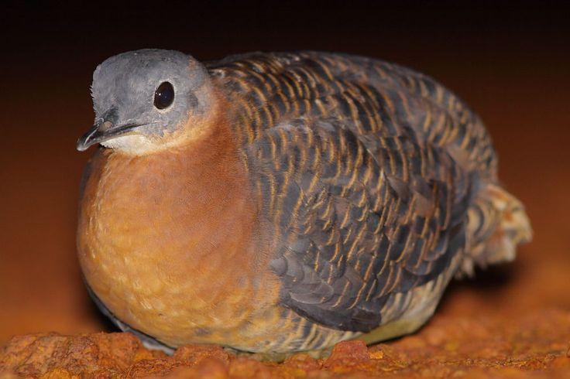
Niche representation metrics
Variegated
tinamou
Geographic space
Niche space
Niche variation
sampled = 98.22 %
Niche volume
protected =75.59 %

Slide 48
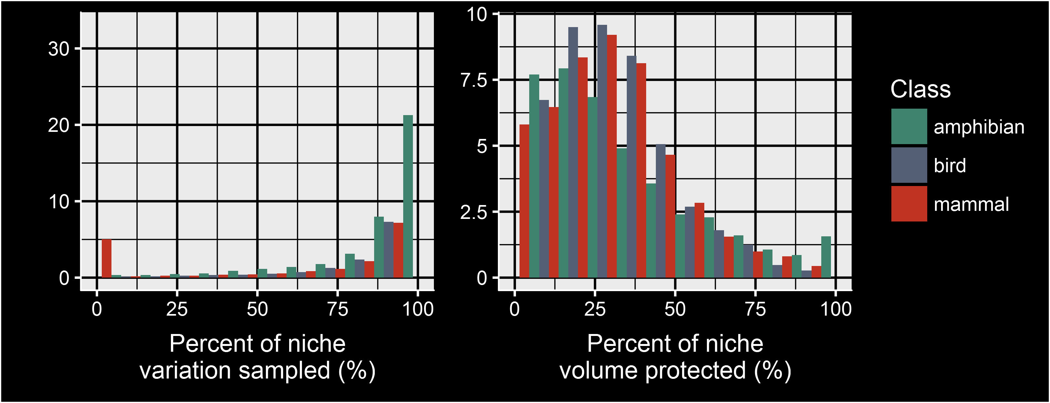
Global niche representation
Percent of species (%)

Slide 49
Global niche representation
Percent of species (%)

Slide 50
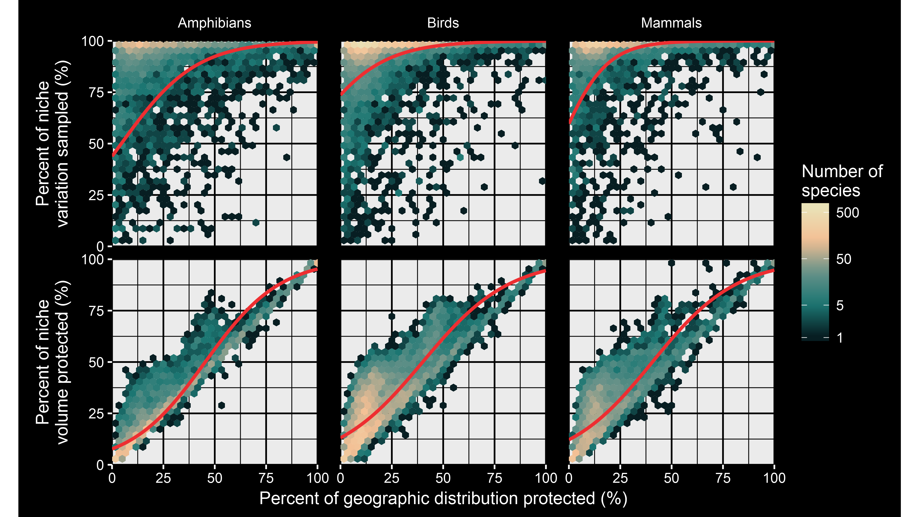

Slide 51
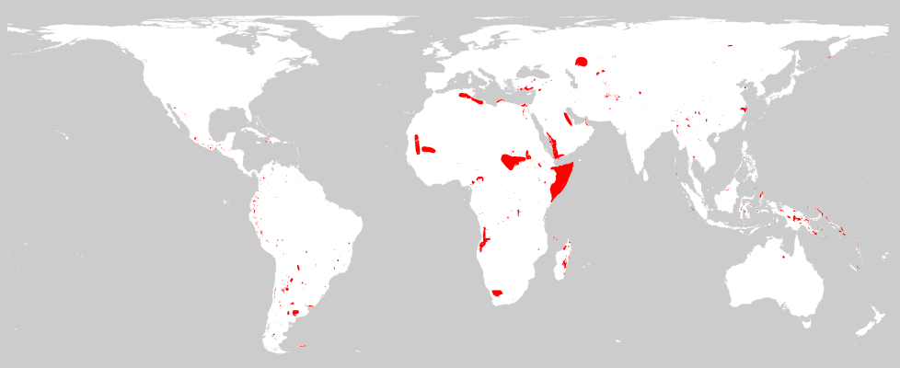
Species missing from protected areas

Slide 52
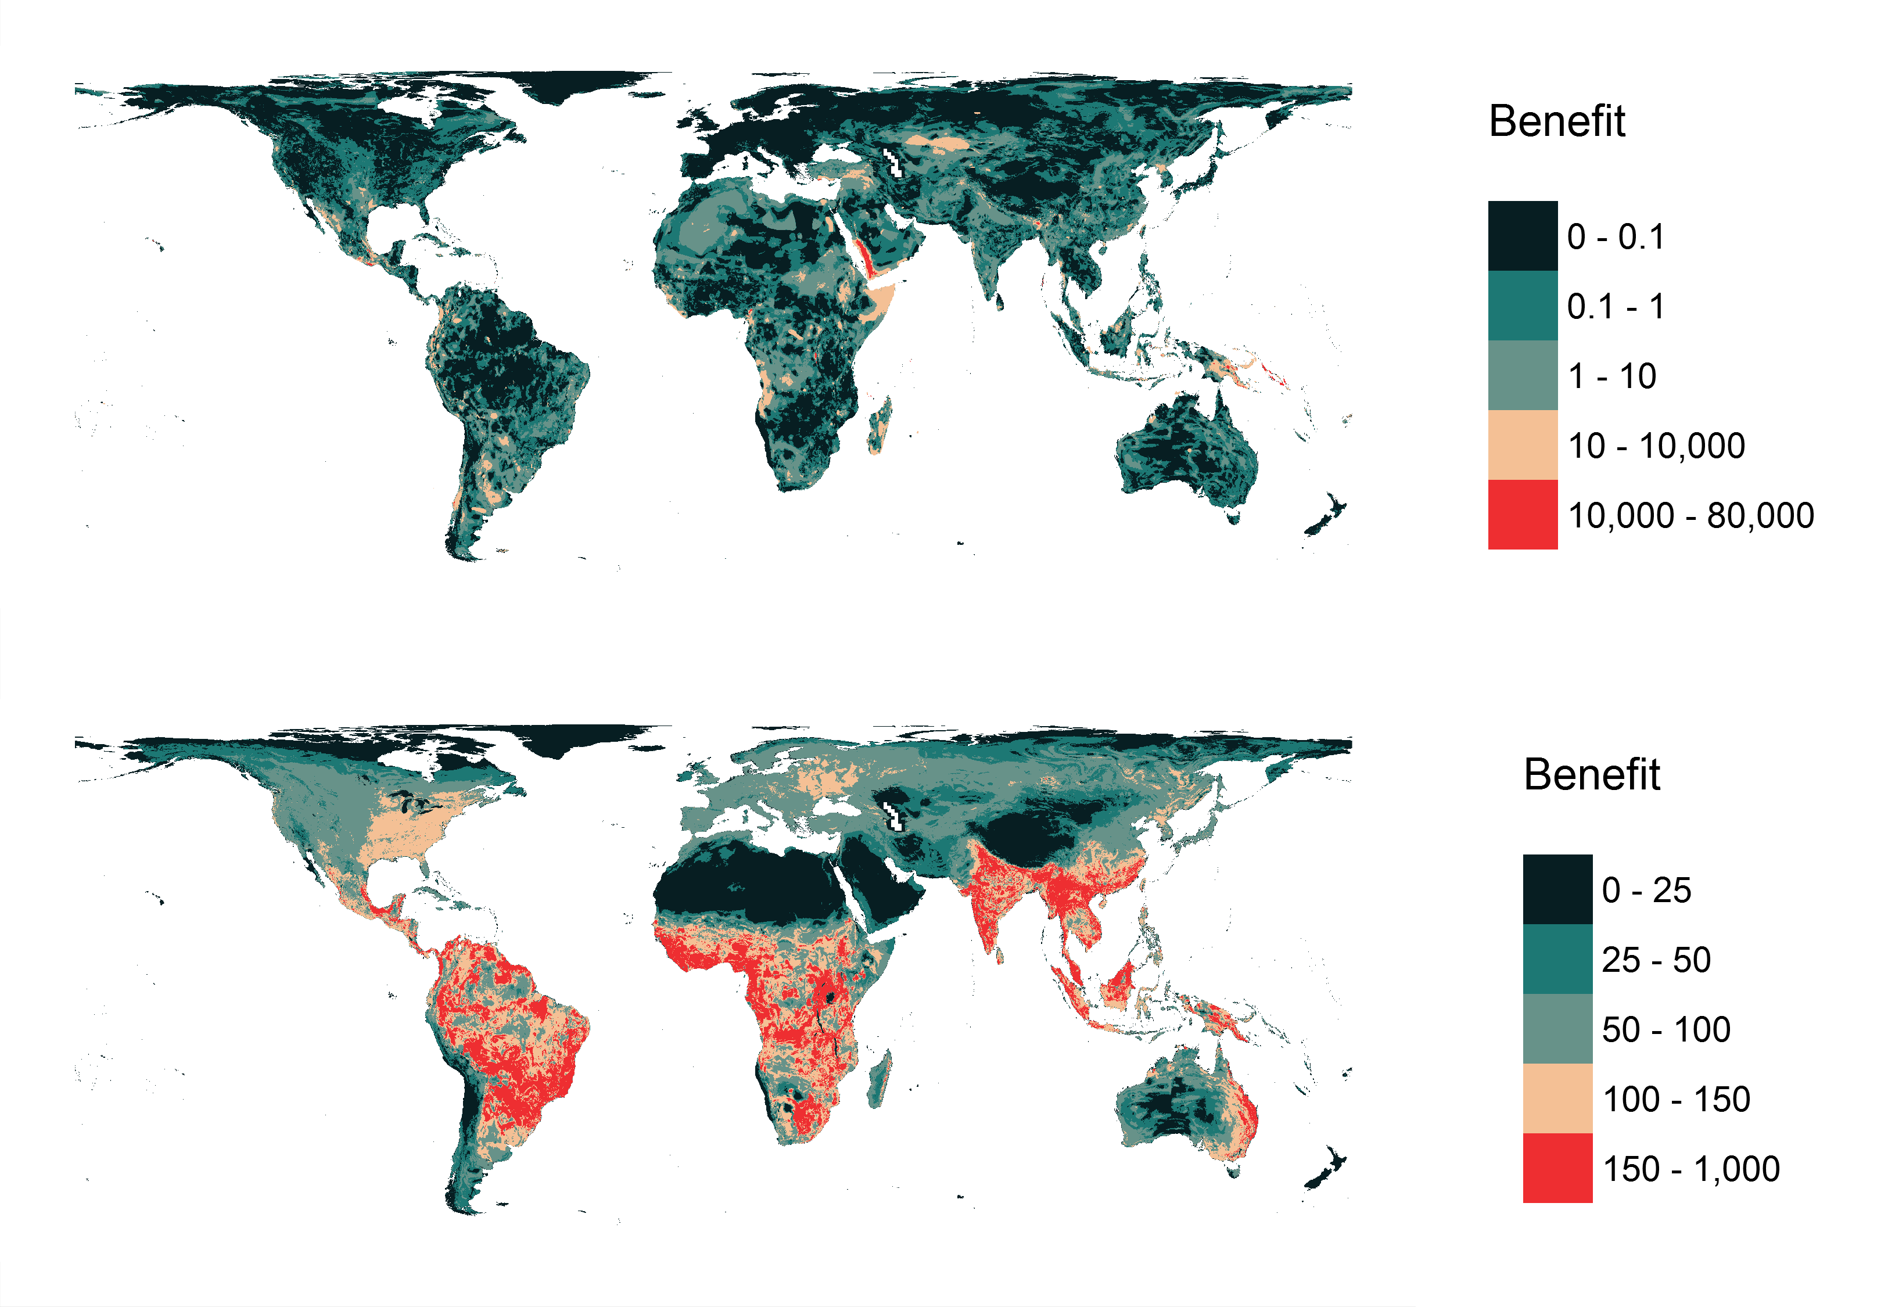
Niche variation benefit

Slide 53
Niche volume benefit

Slide 54
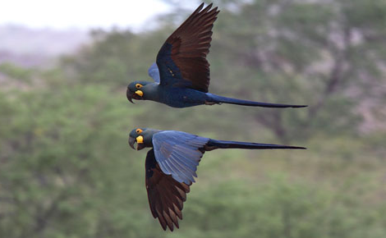
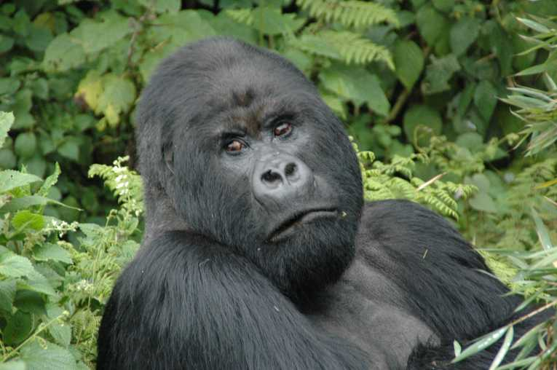
Global conservation of niches
Geographic measures alone aren’t good enough
Protected areas tend to be scattered across species’ niches

Slide 55
Take home messages
If you really want it: you need to plan for it
Surrogates may work – but no guarantees
Plug the gaps!

Slide 56



jeffrey.hanson@uqconnect.edu.au
github.com/jeffreyhanson
jeffrey-hanson.com

